Slide 1
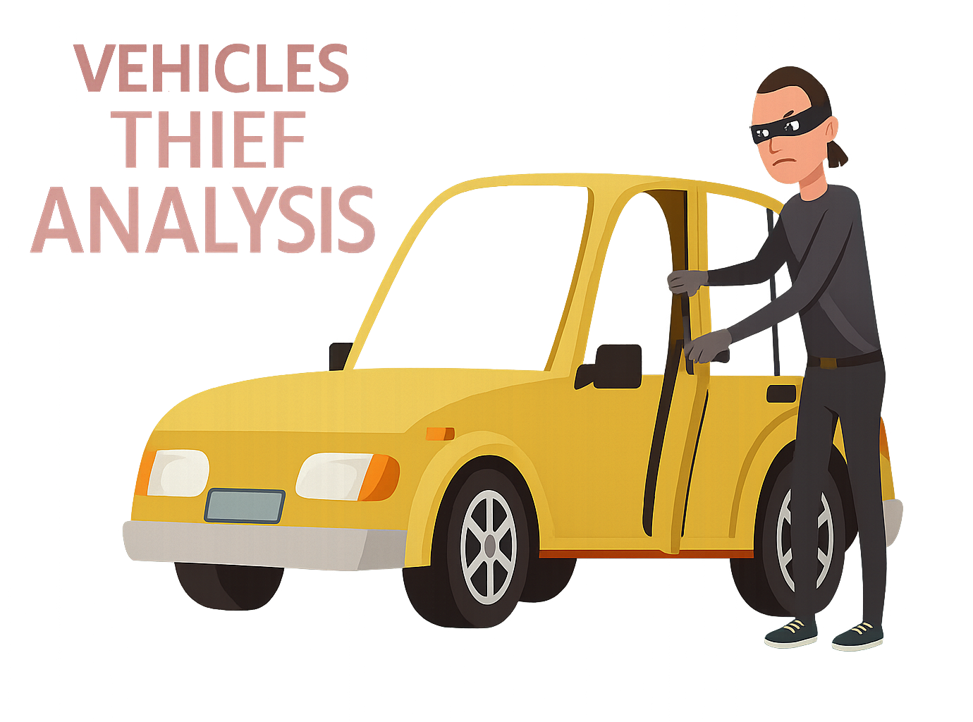

BY
ANUSHA NARAPAREDDY

Slide 2


TABLE OF CONTENT
Project Overview
Data Manipulation
Introduction
Insights
Objectives
Analysis Report
Data Sets
Recommended Analysis
Tools
Recommendations

Slide 3
PROJECT OVERVIEW

Slide 4
PROJECT
Project : Vehicles Theft Analysis
Data Source : Vehicles_Theft_Data
Presented By : Anusha N

Slide 5
INTRODUCTION
This project aims to identify the Patterns, Trends, Risk Factors associated with Stolen Vehicles in New Zealand containing 6 months of data (October 2021 and April 2022).
This Analysis focuses on the Type and Make of Vehicles, Age of the Model, Region and the Population size among other factors using Power BI Reports.
A Time Analysis was conducted to determine the Theft Trends on specific Days of the Week.

Slide 6
OBJECTIVES
To Explore the Vehicle and Date Fields in the Stolen Vehicles table to identify when Vehicles are getting Stolen.
To Explore the Vehicle Type, Age, Make Type such as luxury vs Standard and Colour Fields in the Stolen_Vehicles & Make_Details Tables to identify which Vehicles are getting Stolen.
To Explore the Population and Density Statistics in the Locations Table to identify where Vehicles are getting Stolen.
Identify High-Risk of Make and Vehicle Types.
Analyse Geographical Hotspots of Theft.
Understand Seasonal or Temporal Theft Trends.
Build an Interactive Power BI Report.

Slide 7

DATA SET
Tables Used:
Stolen_Vehicles
Make_Details
Locations
Dataset Structure
Rows
(Stolen_Vehicles : 4553,
Make_Details : 138,
Locations : 16)
Columns
(Stolen_Vehicles : 8,
Make_Details : 3,
Locations : 5)
Data Sets:

Slide 8
TOOLS
Power BI : For Reports, Dashboards and Visualizations
Power Query : For Data Cleaning and Transformation
DAX : For Calculated Columns and Measures
Microsoft Power Point : For Presentation

Slide 9
DATA MANIPULATION
Cleaned and standardized date_stolen column.
Extracted Month, Year, and Weekday from Stolen_Date Column.
Created a separate Date_Table for Time Intelligence.
Calculated Vehicle Age & Categorized into Age Groups.
Key Measures Created:
Current_Month_Theft_Count
Previous_Month_Theft_Count
MOM_Theft_Change%
Theft_Probability

Slide 10
INSIGHTS

Slide 11
INSIGHTS
Insights:
Vehicle_Age
Vehicle_Age_Group
Month_Year
Current_Month_Theft_Count
Previous_Month_Theft_Count
Theft_Probability
MOM_Theft_Change%
Key Metrics:
Total_Stolen_Vehicles : 4553
Avg Age of Stolen Vehicles : 16
Highest Stolen Vehicles Date : 4 April 2022
Highest Stolen Vehicles Color : Silver
Highest stolen Vehicles Region : Auckland
Avg Density : 43 sq.km

Slide 12
VISUALISATIONS
Filters Applied:
Date Filter
Month_Year (Oct 2021 to Apr 2022)
Slicers
Vehicle_Type,
Vehicle_Age_Model,
Make_Type,
Make_Name,
Color,
Region

Slide 13
VISUALISATIONS
Vehicles Theft Summary Report
Total_Stolen_Vehicles : 4553
Highest Stolen Vehicles Color : Silver
Highest stolen Vehicles Region : Auckland
Highest Stolen Vehicles Date : 4 April 2022
Visualizations:
Map : Stolen Vehicles Count by Region
Donut Chart : Stolen Vehicles Count by Year
Funnel Chart : Stolen Vehicles Count by Make_Type
Stacked Bar Chart : Top 5 Vehicle_Types of Stolen Vehicles
Slicer : Month_Year

Slide 14
Vehicle Type & Make Analysis
Visualizations:
Stacked Column Chart : Top 5 Make_Names of Stolen Vehicles
Stolen Vehicles Count by Vehicle_Age_Model
Stolen Vehicles Count by Vehcile_Age_Model & Make_Type
Stolen Vehicles Count by Color
Pie Chart : Top 5 Colors of Stolen Vehicles
Stacked Bar chart : Stolen Vehicles Count by Vehicle_Type
Table : Theft_Probability by Vehicle_Type, Stolen Vehicle Details
Gauge Chart : Total Stolen Vehicles
Slicer : Vehicle_Type, Vehicle_Age_Model,
Make_Type, Make_Name,
Color

Slide 15
Geographical Analysis
Visualizations:
Stacked Bar chart : Stolen Vehicles Count by Region
Scatter Chart : Stolen Vehicles count by Make_Type & Population
Map : Theft_Probability by Region & Make_Type
Gauge Chart : Total Stolen Vehicles
Slicer : Region

Slide 16
Time & Trend Analysis
Visualizations:
Donut Chart : Stolen Vehicles Count by Year
Area Chart : Stolen Vehicles Count by Weekday Name
Line Chart : Stolen Vehicles count by Month_Year
Combo Chart : Total_Vehicles_Count & MOM_Theft_Change% by Year & Month
Stacked Column Chart : Stolen Vehicles Count by Stolen_Date (Each Day)
Gauge Chart : Total Stolen Vehicles
Filters : Month_Year

Slide 17
ANALYSIS

Slide 18
ANALYSIS
Total_Stolen_Vehicles = 4553
Total No. of Vehicle_Types = 26
Total No. of Make_Type = 2
=> (Standard & Luxury)
Total No. of Make_Names = 138
Total No. of Vehicle Colors = 15
Total Population = 5 M
Total Regions = 16
Stolen Period = 6 Months
=> (Oct 2021 to Apr 2022)
Highest Stolen Vehicles Color : Silver
Highest stolen Vehicles Region : Auckland
Highest Stolen Vehicles Date : 4 April 2022
Highest stolen Vehicle Model : Old Model
Avg Age of Stolen Vehicles : 16
Avg of Density : 43
Vehicle_Age_Models = 3
=> (Latest, Old, Vintage Models)

Slide 19
Vehicle Type & Make Analysis
Vehicles Theft has been placed in 16 various Regions of the Country New Zealand.
Silver is the most frequently stolen Vehicle Color, with a total of 1272 reported Stolen Vehicles.
And the Least Solen Vehicle Color is Pink of 4 Vehicles.
Vehicle Thefts peaked in 2022 with 2885 representing 63% of the Total Stolen Vehicles, compared to 1668 (37%) Stolen Vehicles in 2021.
Standard Make Vehicles are the Most frequently stolen accounting for 4363, while Luxury Makes recorded only 190 Vehicles.
Stationwagon leads as the Most stolen Vehicle Type (945 Vehicles), followed by Saloon, Hatchback, Trailer, and Utility.
So, the Theft Probability of Stationwagon in Vehicle_Type is also High.
Toyota is the Most stolen Vehicle Make with 716 among all the Makes, followed by Trailer, Nissan, Mazda, and Ford.
The Highest number of stolen Vehicles fall under the ‘Old Model' category (3–20 Years old).
Within this group, 2577 are Standard Make Types, while 147 are Luxury vehicles.

Slide 20
Geographical Analysis
Vehicles Theft has been placed in 16 various Regions of the Country New Zealand.
The Total Population of the Regions / Locations where Vehicle Thefts occurred based on the provided data is approximately 5 Million.
The Average Density in Theft-affected Areas is 43 persons/km².
Auckland recorded the Highest number of Vehicle Thefts with 1638 incidents, while Southland reported the Least with only 26 cases. There was NO Vehicle Theft in the West Coast, Marlborough, or Tasman Regions.
Gisborne has the Highest Vehicle Theft_Probability of Standard Make Types, while Waikato reports the Highest number of Thefts involving Luxury Make Vehicles.
Standard Make Vehicles consistently Increase in Theft count as the Population grows across different Regions.
Luxury Make Vehicles have a Lower overall Theft count compared to Standard Make Vehicles, even as Population size Increases.

Slide 21
Time & Trend Analysis
Monday had the Highest number of stolen Vehicles i.e. 767 Vehicles, while Saturday had the Lowest i.e. 577 Vehicles during the 6 Month of Data Time frame.
Vehicle Thefts reached their Highest Daily Count on 4th April 2022.
In Auckland, 9 Vehicles are stolen on Average Every Day.
A total of 4553 Vehicles were reported stolen, with 25 vehicles stolen every day on average.
The Monthly Vehicle Theft Count Raise gradually reaching a Peak of 1053 Vehicles in March 2022.
This was followed by a sharp Decline with April 2022 recording the Lowest number of Thefts in the period.
This rising Trend was marked by Positive Month-over-Month Change especially +63.5% Increase in March 2022.
However, there was a sharp Decline in April 2022 with Thefts Dropping to 329 representing an -86.60% Decrease from March.

Slide 22
ANALYSIS REPORT

Slide 23
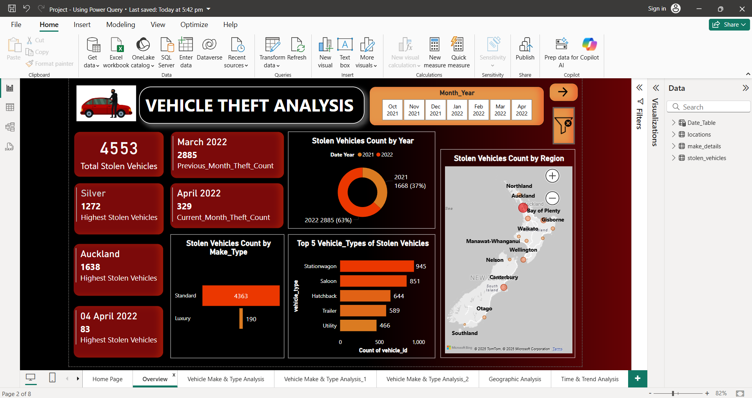
Vehicle Theft Analysis Report (Overview)

Slide 24
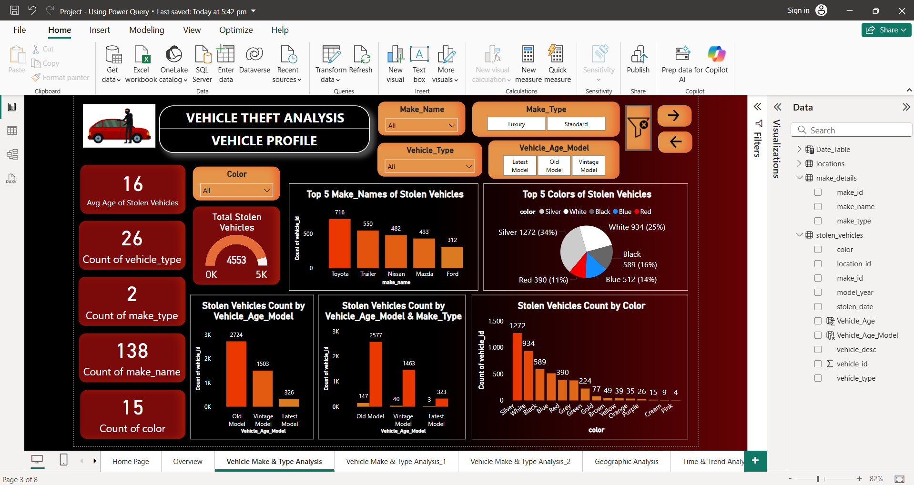
Vehicle Type & Make Analysis

Slide 25
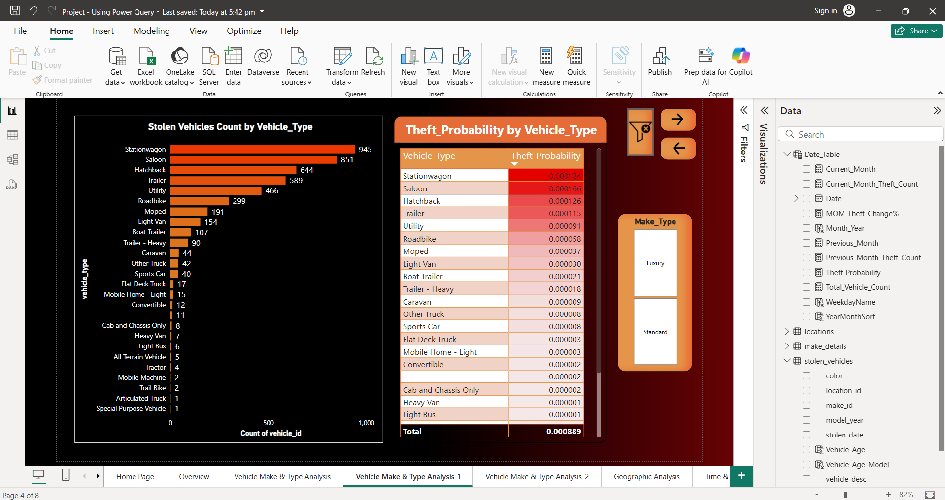
Vehicle Type & Make Analysis

Slide 26
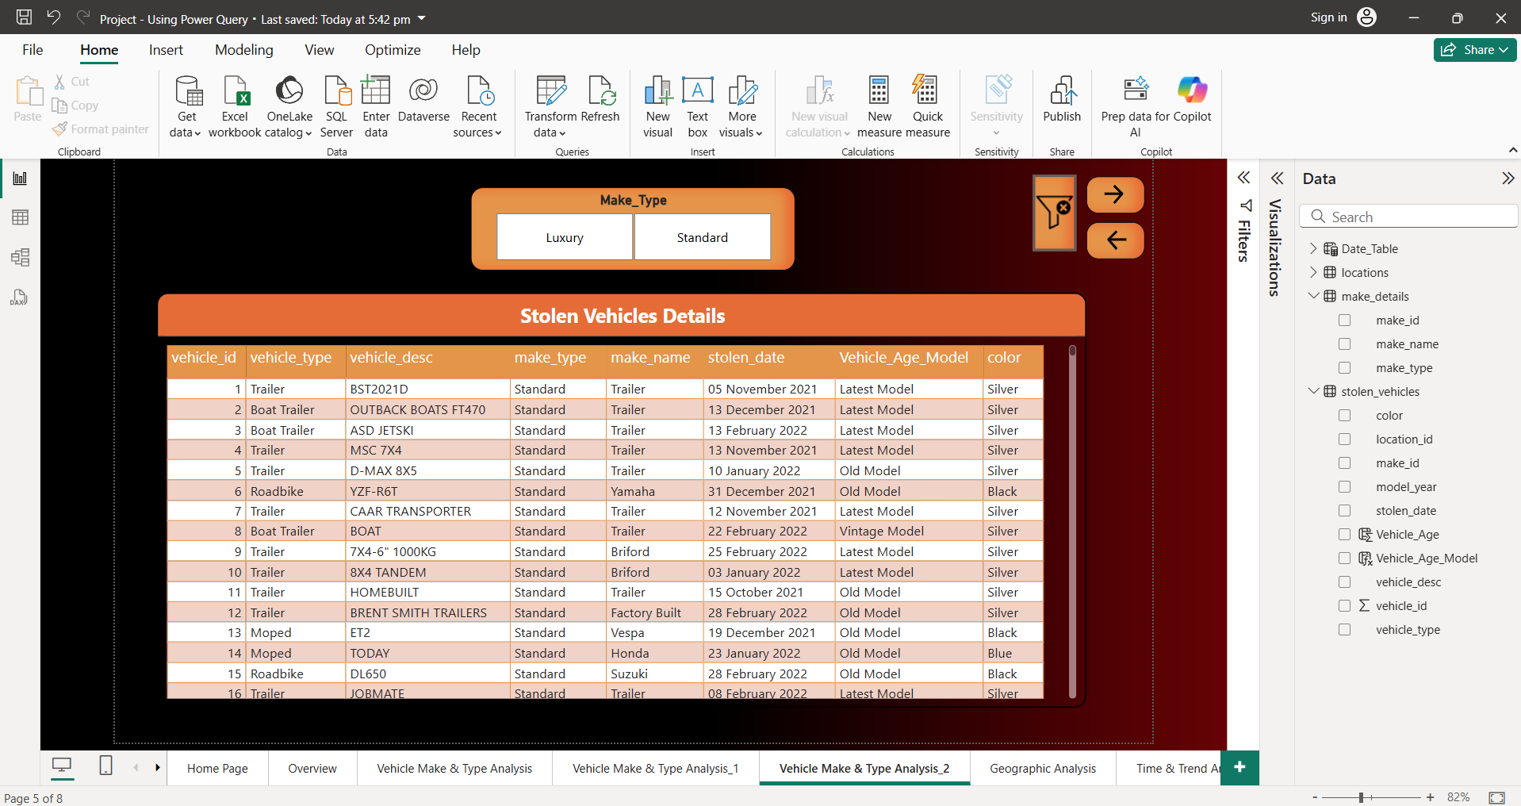
Vehicle Type & Make Analysis

Slide 27
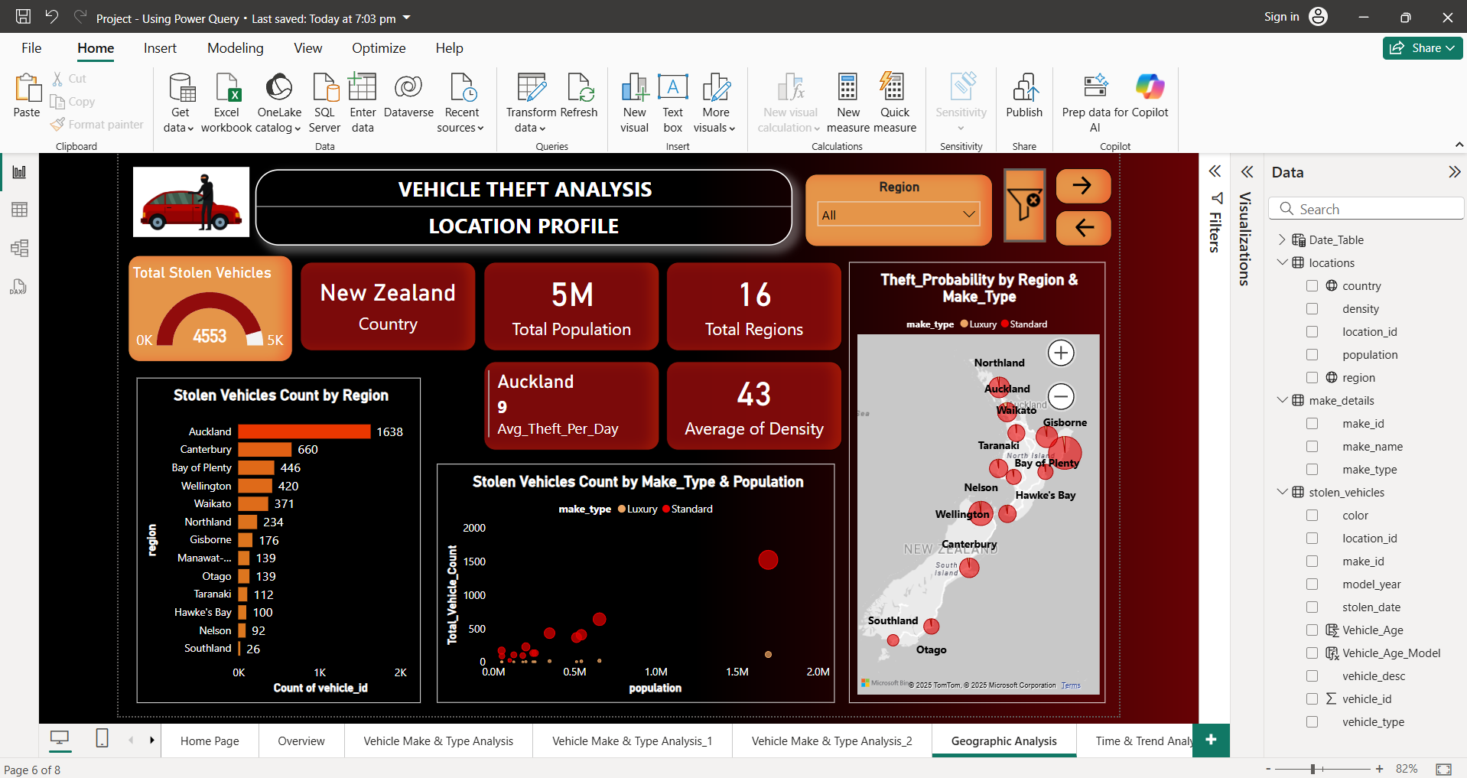
Geographical Analysis (Location & Region)

Slide 28
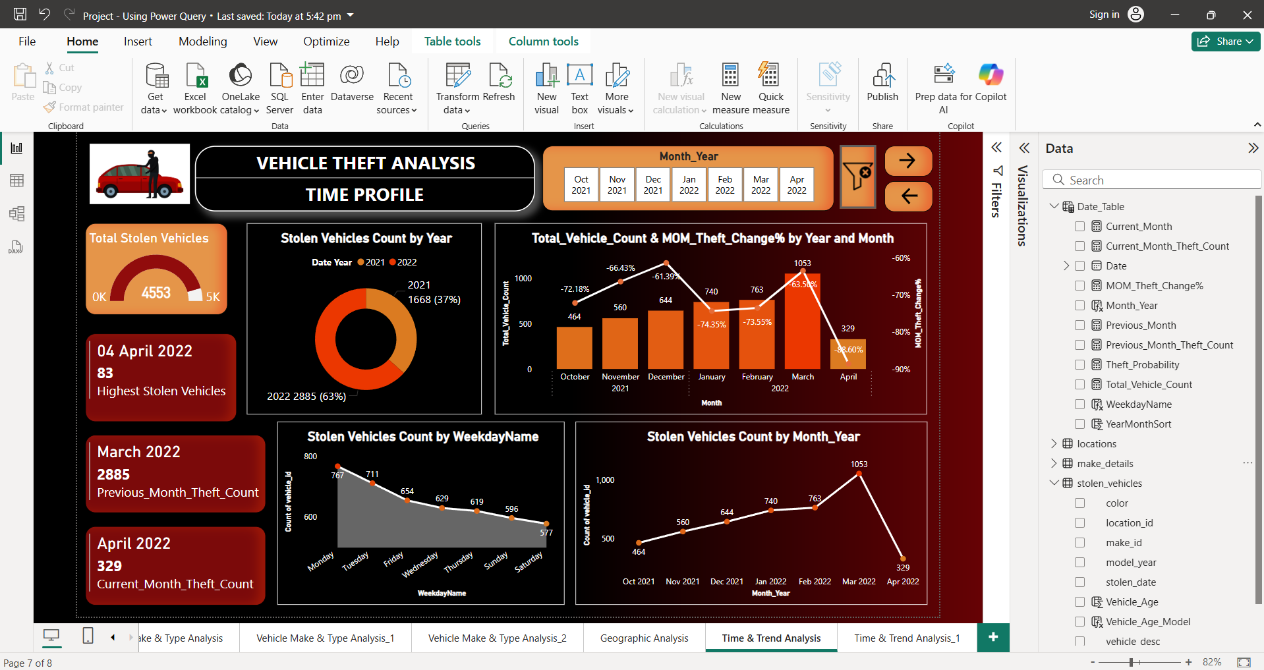
Time & Trend Analysis

Slide 29
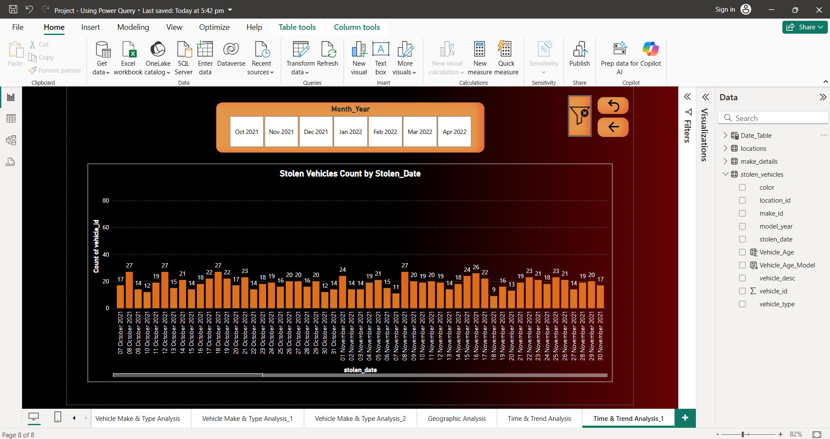
Time & Trend Analysis

Slide 30
RECOMMENDED ANALYSIS

Slide 31
RECOMMENDED ANALYSIS
Recommended Analysis refers to the Areas that needs deeper Exploration or further Study to uncover hidden Trends, Patterns, or Optimization opportunities.
Extract Month, Year, and Weekday from Stolen_Date Column to understand Monthly or Weekly Trends in Vehicle Thefts.
Created a separate Date_Table for Time Intelligence.
Identify Theft Patterns by Day.
Determine the Day of Week are Vehicles Most often & Least often Stolen ?
What Types of Vehicles are Most often & Least Stolen in various Regions ?
Identify Hotspots of Vehicle Theft.
Calculated Vehicle Age & Categorized into Age Groups.
What is the Average Age of Vehicles that are Stolen ?
Find the Relationship between Population Density & Theft Count ?

Slide 32
TRENDS
Vehicle Theft is predominantly seen in Standard Make Types, which accounted for 95.8% of Thefts (4363 out of 4553), whereas Luxury Vehicles made up just 4.2% (190).
Stolen vehicles are predominantly from the Old Model Category (3–20 Years old) highlighting higher vulnerability among older models.
Theft varied by Day of the Week over 6 Months with the Highest Thefts on Mondays (767) and the Lowest on Saturdays (577) suggesting a potential Weekday Trend.
Vehicle Thefts showed a Steady Upward Trend from October 2021 and Peak at March 2022 with 1053 Stolen Vehicles, followed by a sudden drop in April 2022 with 329 Stolen Vehicles.
There is a Partial Correlation between Vehicle Thefts and Population Density:
- Strong in High-Density Areas (High Population)
- Weak or Inconsistent in Lower-Density Regions (Low Population)

Slide 33
RECOMMENDATIONS

Slide 34
RECOMMENDATIONS
Recommendations are the Actionable Suggestions based on current Findings, aimed at Improving future Performance and Strategy.
🔐 1. Strengthen Vehicle Security Measures
Encourage Use of Anti-Theft Devices & Security Measures to the High-Risk Vehicles such as Station wagons Vehicle Type, Silver Colored Vehicles, Standard Make Type Vehicles.
Adopt Advanced Security Features like of Steering Wheel Locks, Sensitive Alarms to deter Theft, Lock Designs.
Adopt GPS Tracking Systems to facilitate Quick Recovery of Stolen Vehicles.
🧠 2. Enhance Public Awareness
Launch Awareness Campaigns highlighting the prevention tips at Theft Hotspots such as Auckland.
Educate Vehicle Owners about the importance of securing their vehicles and avoiding common mistakes, such as Leaving Keys inside or vehicles running unattended.
🗺️ 3. Utilize Data Analytics for Targeted Interventions
Identify High-Risk Areas using data to pinpoint Regions with elevated Theft Rates and Allocate Resources accordingly.
Focus more on High-Risk Regions which are Densely populated such as Auckland.
Monitor Trends & Analyze Temporal Patterns to proactively identify possible spikes in criminal activity. Enhance Police Presence and Community Surveillance Efforts with particular focus on High-Risk Days such as Mondays when the highest number of vehicle thefts typically occur.

Slide 35
THANK YOU

